Slide 1
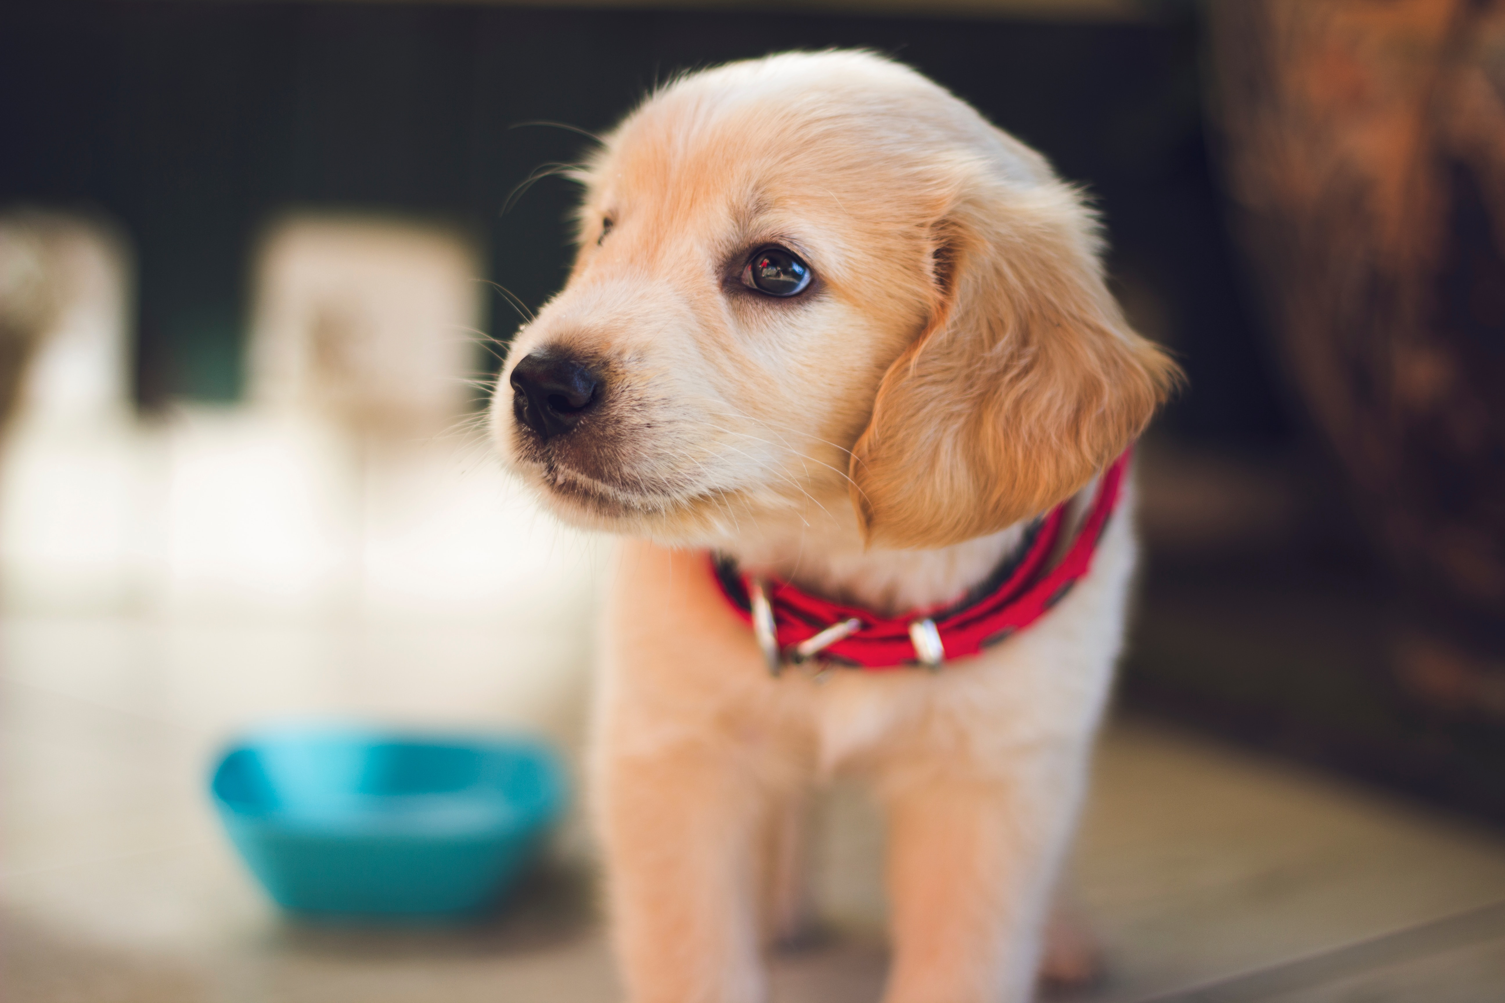
DoggyGuide
236503 – Project in Software – Android Applications Winter 19-20
Developed by: Itay Israelov, Assel Qizel
Supervisor: Sahar Cohen

Slide 2
Introduction
The purpose of our app is first to help the dog owner with daily care, such as setting up reminders for basic activities like feeding, walking and bathing your dog. Secondly, the goal is to help the dog owner to communicate with other dog owners at the Technion in a convenient way, such as finding someone who can Keep the dog when needed or "play dates" with other dogs. And finally, its goal is to conveniently link the dog owner to the organization to which the guide dog belong, such as announcing vaccines, training or treatments that should occur soon.

Slide 3

External Tools
Firebase Authentication - We used this tool to manage sign in methods and authentication for the app users, we had two sign-in options, Email and password or Gmail account.
Cloud Firestore – This tool is the database we used for our app.
Firebase Storage – Our media storage, used for uploading pictures to the cloud and downloading them in run time.
Cloud Messaging – We used this tool alongside with Cloud Functions which were implemented with Nodejs, with the help of this tool we managed to send notifications and write data to our database with maximum real-time speed.
Zelory Image Compressor – Used this tool in order to be able to compress images and upload them to the storage so the app would be more responsive on loading the media back from the database.

Slide 4
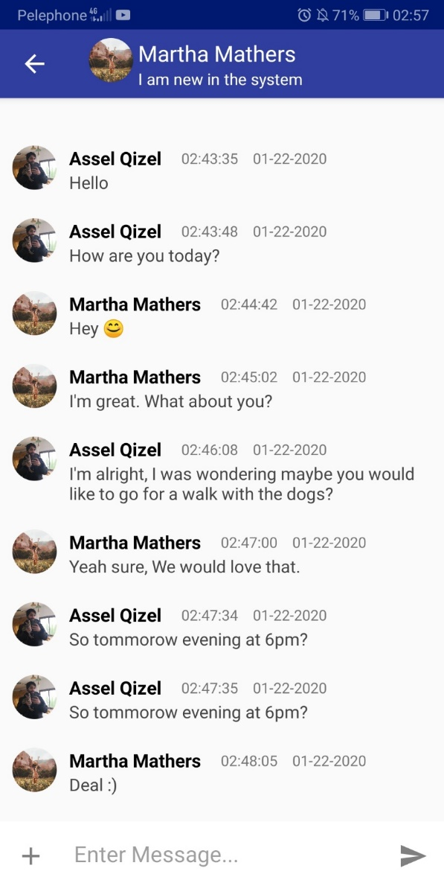
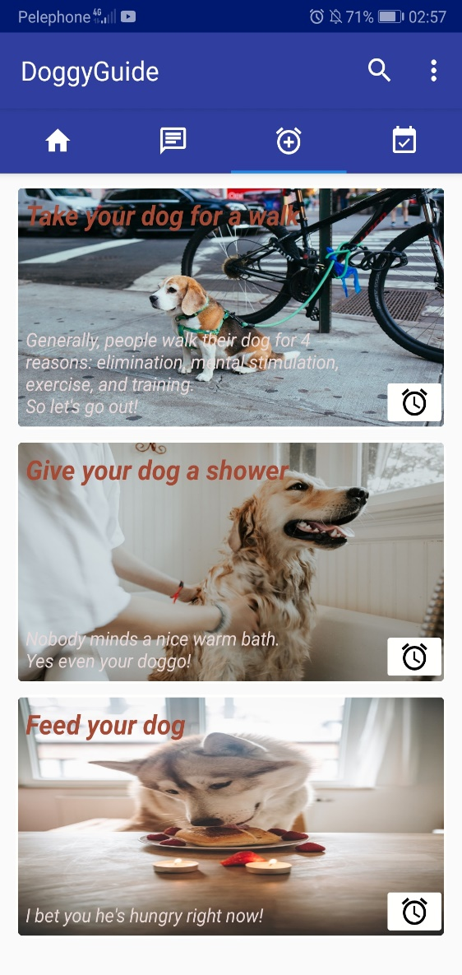
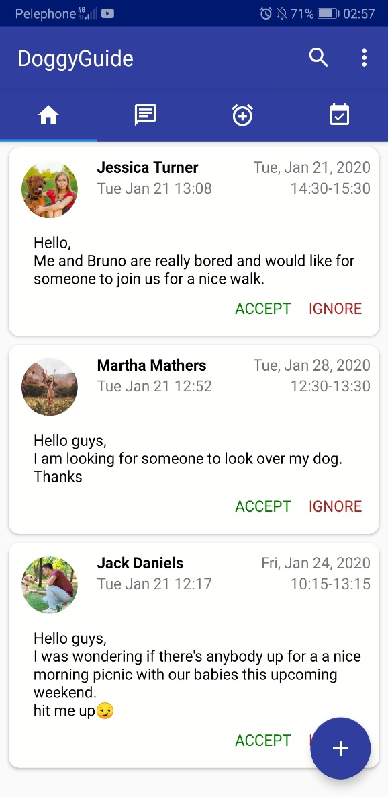
Implemented Features
Reminders – As a dog owner who uses the app, you can set up reminders to help you manage your time properly.
Events – You can look at your calendar to see your upcoming important dates and events, also you can set an alarm time remind you of them.
Posts – You can share your ideas with your friends
Friends – You can add friends who are using the same app in order to communicate with them.
Chat – You can message your friends and talk to them.

Slide 5
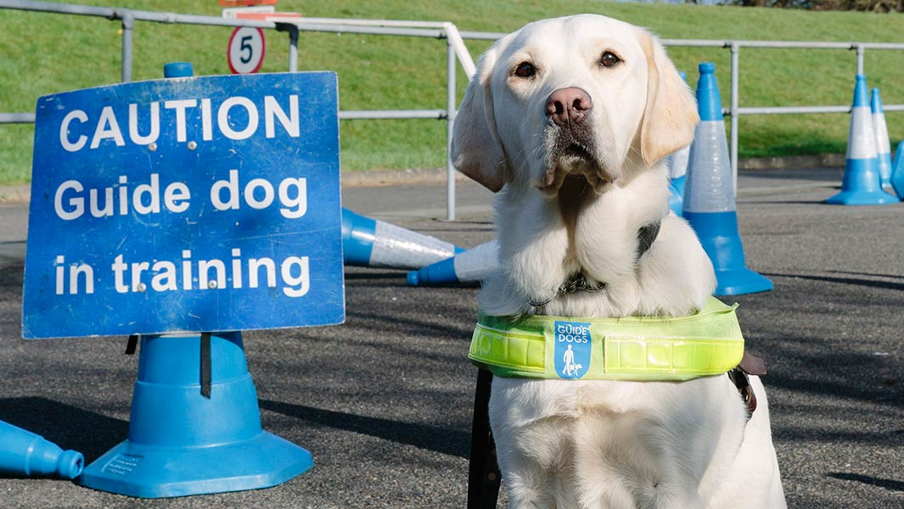
Future Plans
The idea of the app could go much further than the what have achieved this semester. The way we see it the app would be much more focused on the Organizations role of the dog upbringing role, Guide Dogs go through scheduled training with a trainer and would have to leave their temporary owner for more intense training to go eventually do their job as guide dogs.
More communication with the organization, such as sending broadcast to inform dog owners of a group meeting, vaccines, trainings ,etc…
Tracker, meaning a platform to track the dogs improvement and readiness based on the report of the dogs trainer to the organization, based on the dogs mental and physical maturity.

